Slide 1
INTRODUCTION TO DATA MINING
Chapter 0 & 1

Slide 2
References
Principles of Data Mining – Max Bramer(2nd Ed)
Data Mininig Concepts and Techniques – Jiawei Han, Michaline Kamber, Jian Pei, 3rd Ed.
www.saedsayad.com

Slide 3
Basic
Data
  a "given" or a fact that represents something in real world
  raw materials, can be processed, structured or unstructured
  Data are elements of analysis
Information
  Data that have meaning in context
  Data related
  Data after manipulation
Knowledge
  familiarity, awareness and understanding of someone or something
  acquired through experience or learning
  it is a concept mainly for humans unlike data and information.
Knowledge is not information and information is not data.
Knowledge is derived from information in the same way information is derived from data.
Data Rich but Knowledge Poor
Notes:
Data are elements of analysis.
Information is data with context.
Knowledge is information with meaning

Slide 4
What is data mining?
Data mining is the practice of automatically searching large stores of data to discover patterns and trends that go beyond simple analysis.
Data mining is also known as Knowledge Discovery in Data (KDD).
[oracle]

Slide 5
Data Explosion
  POS Machine Data
  Banking Transactions
  Credit Card Data
  Earth Observation Satellites
  Human Genome Project
  CCTV Recordings
  WWW Contents

Slide 6
Key Properties & Objective
Key Properties
  Automatic discovery of patterns
  Prediction of likely outcomes
  Creation of actionable information
  Focus on large data sets and databases
Objective
  Automated prediction of trends and behaviors
  Automated discovery of previously unknown patterns

Slide 7
Applications of Data Mining
Credit card fraud detection
  a credit card company can use its data warehouse of customer transactions for fraud detection
Financial forecasting
Medical diagnosis
  predicting the probability that a cancer patient will respond to chemotherapy, thus reducing health-care costs without affecting quality of care.
Targeted marketing
Weather forecasting
Social Trend Mining
Notes:
Some examples of applications (potential or actual) are:
– a supermarket chain mines its customer transactions data to optimise targeting
of high value customers
– a credit card company can use its data warehouse of customer transactions
for fraud detection
– predicting the probability of default for consumer loan applications by improving
the ability to predict bad loans
– predicting the probability that a cancer patient will respond to chemotherapy,
thus reducing health-care costs without affecting quality of care.

Slide 8
Basic Terminology
Object
  anything that is visible or tangible and is relatively stable in form. [dictionary.com]
  Real-world objects share two characteristics: They all have state and behavior. [oracle]
Attribute/Variable
  Each object is described by number of variables that correspond to its properties. In data mining variables are often called attributes. Examples: eye color of a person
  Categorical (qualitative):Categorical variables take on values that are names or labels. The color of a ball (e.g., red, green, blue)
  Continuous (quantitative) : Quantitative variables are numerical. They represent a measurable quantity. when we speak of the population of a city, we are talking about the number of people in the city.

Slide 9
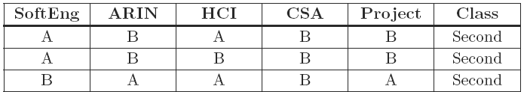
Basic Terminology
Instance/Record
  The set of variable values corresponding to each of the objects is called a record or (more commonly) an instance.
Dataset
  The complete set of data available to us for an application is called a dataset. A dataset is often depicted as a table, with each row representing an instance. Each column contains the value of one of the variables (attributes) for each of the instances.
Class attribute

Slide 10
Data Types
Two types of data: Labelled Data & Unlabelled Data
Labelled data
  Specially designated attribute and the aim is to use the data given to predict the value of that attribute for instances that have not yet been seen.
  SoftEng=A, ARIN=A, HCI=B, CSA=B, Project=A, THEN Class = ?

Slide 11
Data Types
  Unlabelled data
    Data that does not have any specially designated attribute is called unlabelled.
    Here the aim is simply to extract the most information we can from the data available.
Date | Name | Shop Name | Products | …
25/09/2014 | Marcos | ABC |  | …
27/09/2014 | Marcos | ABC | Pen, Bread, Cake | …
05/10/2014 | Marcos | ABC | Bread, Cheese | …

Slide 12
Learning Methods
Supervised Learning
  Data mining using labelled data is known as supervised learning.
  Classification
    If the designated attribute is categorical, the task is called classification.
    Classification is one form of prediction, where the value to be predicted is a label.
    a hospital may want to classify medical patients into those who are at high, medium or low risk
    we may wish to classify a student project as distinction, merit, pass or fail
    Nearest Neighbour Matching, Classification Rules, Classification Tree, …

Slide 13
Learning Methods
  Numerical Prediction (Regression)
    If the designated attribute is numerical, the task is called numerical prediction (regression).
    Numerical prediction (often called regression) is another. In this case we wish to predict a numerical value, such as a company’s profits or a share price.
    A very popular way of doing this is to use a Neural Network

Slide 14
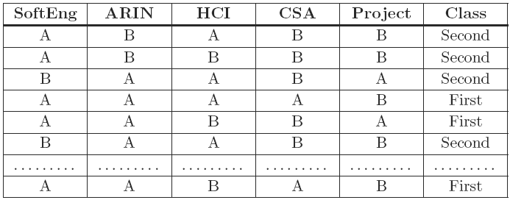
Learning Methods

Slide 15
Learning Methods
Unsupervised Learning
  Data mining using unlabelled data is known as unsupervised learning.
  Association Rules
    Sometimes we wish to use a training set to find any relationship that exists amongst the values of variables, generally in the form of rules known as association rules.
    APRIORI
    Market Basket Analysis
  Clustering
    Clustering algorithms examine data to find groups of items that are similar.
    K-Means Clustering, Agglomerative Hierarchical Clustering

Slide 16
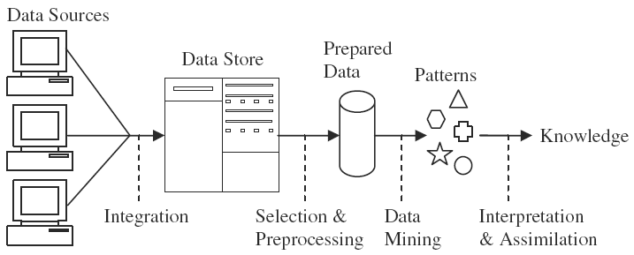
Knowledge Discovery
Non-Trivial Extraction of implicit
Data from different sources are integrated and stored
Attribute Selection and Preprocessed in standard format
Data is feed to mining algorithm to produce some rule or pattern
Rules or patterns are interpreted to discover knowledge
Notes:
Data comes in, possibly from many sources. It is integrated and placed
in some common data store. Part of it is then taken and pre-processed into a
standard format. This ‘prepared data’ is then passed to a data mining algorithm
which produces an output in the form of rules or some other kind of ‘patterns’.
These are then interpreted to give—and this is the Holy Grail for knowledge
discovery—new and potentially useful knowledge.

Slide 17
Types of Attribute/Variable
Mainly six types of Attribute
  Nominal
    A variable used to put objects into categories, e.g. the name or color of an object.
    A nominal variable may be numerical in form, but the numerical values have no mathematical interpretation.
  Binary
    A binary variable is a special case of a nominal variable that takes only two possible values: true or false, 1 or 0 etc.

Slide 18
Types of Attribute/Variable
  Ordinal
    Ordinal variables are similar to nominal variables, except that an ordinal variable has values that can be arranged in a meaningful order, e.g. small, medium, large.
  Integer
    Integer variables are ones that take values that are genuine integers
    Unlike nominal variables that are numerical in form, arithmetic with integer variables is meaningful
  Interval-Scaled
  Interval scale variables are measured on a linear scale, and can take on positive or negative values.
  temperatures in Celsius or Fahrenheit

Slide 19
Types of Attribute/Variable
  Ratio-Scaled
  Ratio-scaled variables are similar to interval-scaled variables except that the zero point does reflect the absence of the measured characteristic, for example temperature in Kelvin, length, time, counts
Many practical data mining systems divide attributes into just two types: categorical [nominal, binary, ordinal] and continuous [integer, interval-scaled, ratio-scaled]
Ignore attribute
  Corresponding to variables that are of no significance for the application

Slide 20
Data Preparation
Data Cleaning
  Even when the data is in the standard form it cannot be assumed that it is error free.
  In real-world datasets erroneous values can be recorded for a variety of reasons, including measurement errors, subjective judgements and malfunctioning or misuse of automatic recording equipment.
  Noisy value
    a noisy value to mean one that is valid for the dataset, but is incorrectly recorded
    the number 69.72 may accidentally be entered as 6.972, or a categorical attribute value such as brown may accidentally be recorded as another of the possible values, such as blue.
  Invalid value
    69.7X for 6.972 or bbrown for brown
    An invalid value can easily be detected and either corrected or rejected

Slide 21
Data Preparation
Missing Values
  In many real-world datasets data values are not recorded for all attributes. This can happen simply because there are some attributes that are not applicable for some instances, a malfunction of the equipment used to record the data, a data collection form to which additional fields were added after some data had been collected, information that could not be obtained, e.g. about a hospital patient…
  Discard Instances
    This is the simplest strategy: delete all instances where there is at least one missing value and use the remainder.
    It has the advantage of avoiding introducing any data errors. Its disadvantage is that discarding data may damage the reliability of the results derived from the data

Slide 22
Data Preparation
  Replace by Most Frequent/Average Value
    A less cautious strategy is to estimate each of the missing values using the values that are present in the dataset.
    A straightforward but effective way of doing this for a categorical attribute is to use its most frequently occurring (non-missing) value
    In the case of continuous attributes it is likely that no specific numerical value will occur more than a small number of times. In this case the estimate used is generally the average value.
Reducing the Number of Attributes
  Feature reduction, dimension reduction

Slide 23
References
http://www.dictionary.com/browse/object
https://docs.oracle.com/javase/tutorial/java/concepts/object.html

